Slide 1
eCourse Progress Report – Sprint B
Pedro Mesquita – 1211171
Luís Monteiro – 1211250
Miguel Pessanha – 1201078
Tiago Afonso - 1201305

Slide 2
Topics
Project
Courses
Exams
Shared Boards

Slide 3
Planning
 | % | % | Esta | 2023
 |  | (N-1) |  | Mar | Abr | Mai | Jun | Jul | Ago | Set | Out | Nov
eCourse | 100% | 10% | ●
Sprint A | 0% | 100% | ●
Domain Model | 0% | 100% | ✓
 | 0% | 100% | ✓
 | 0% | 100% | ✓
 | 0% | 100% | ✓
Sprint B | 40% | 40% | ●
Courses | 12% | 100% | ✓
Exams | 10% | 50% | ●
Shared Boards | 10% | 50% | ●
Presentation | 8% | 100% | ●
Sprint C | 60% | 20% | ●
Exams | 24% | 50% | ✓
Shared Boards | 24% | 50% | ✓
Presentation | 12% | 70% | ●
 | 0% | 0% | ●
Conclusão Sprint A
Conclusão Sprint B
Conclusão
Sprint C

Slide 4
Completed Activities
ID | Atividade | Responsável | Baseline | Real | Estado
1001 | Register, Enable/Disable & List Users | Tiago Afonso / Pedro Mesquita | Start: 07-05-2023 End: 09-05-2023 | Start: 07-05-2023 End: 10-05-2023 | ✓
1002 | Create courses | Tiago Afonso | Start: 15-05-2023 End: 18-05-2023 | Start: 10-05-2023 End: 15-05-2023 | ✓
1003 | Open and close enrollments | Tiago Afonso | Start: 15-05-2023 End: 18-05-2023 | Start: 15-05-2023 End: 18-05-2023 | ✓
1004 | Open and close courses | Tiago Afonso | Start: 14-05-2023 End: 20-05-2023 | Start: 14-05-2023 End: 20-05-2023 | ✓
1005 | Set the teachers of a course | Tiago Afonso | Start: 14-05-2023 End: 20-05-2023 | Start: 14-05-2023 End: 20-05-2023 | ✓
1006 | List all the courses that are available to me | Tiago Afonso | Start: 14-05-2023 End: 20-05-2023 | Start: 14-05-2023 End: 20-05-2023 | ✓
1008 | Request my enrollment in a course | Pedro Mesquita | Start: 27-09-2020 End: 07-10-2020 | Start: 18-05-2023 End: 05-06-2023 | ✓
1009 | Approve or reject student applications | Pedro Mesquita | Start: 27-09-2020 End: 07-10-2020 | Start: 18-05-2023 End: 05-06-2023 | ✓
1010 | Schedule a class | Pedro Mesquita | Start: 19-05-2023 End: 21-05-2023 | Start: 19-05-2023 End: 21-05-2023 | ✓

Slide 5
Uncompleted Activities
ID | Atividade | Responsável | Baseline | Real | Estado
2001 | Create/Update an exam | Tiago Afonso / Miguel Pessanha | Start: 01-06-2023 End: 10-10-2023 | Start: 10-06-2023 End: 15-06-2023 | ●
2002 | View a list of my future exams |  | Start: End: | Start: End: | ●
2003 | View a list of all exams in a course |  | Start: End: | Start: End: | ●
3001 | Prepara communication infrastructure for Shared Boards | Miguel Pessanha / Luís Monteiro | Start: 10-06-2023 End: 13-06-2023 | Start: 10-06-2023 End: 14-06-2023 | ●
3002 | Create a Board | Luís Monteiro | Start: 05-05-2023 End: 15-05-2023 | Start: 05-05-2023 End: 09-06-2023 | ✓
3003 | Explore synchronization problem | Miguel Pessanha | Start: 10-05-2023 End: 20-05-2023 | Start: 10-05-2023 End: 19-05-2023 | ✓
5001 | This presentation | Everyone | Start: 19-05-2023 End: 21-05-2023 | Start: 19-05-2023 End: 21-05-2023 | ●

Slide 6
Topics
US 5001
As software product client, I want the team (software product supplier) to prepare a presentation focusing on the following aspects:
main objectives of the system;
adopted development process and planning;
teamwork methodology and conflict resolution strategy
product quality;
expected results;
'turnkey' format for software delivery/sale; among others relevant aspects.

Slide 7
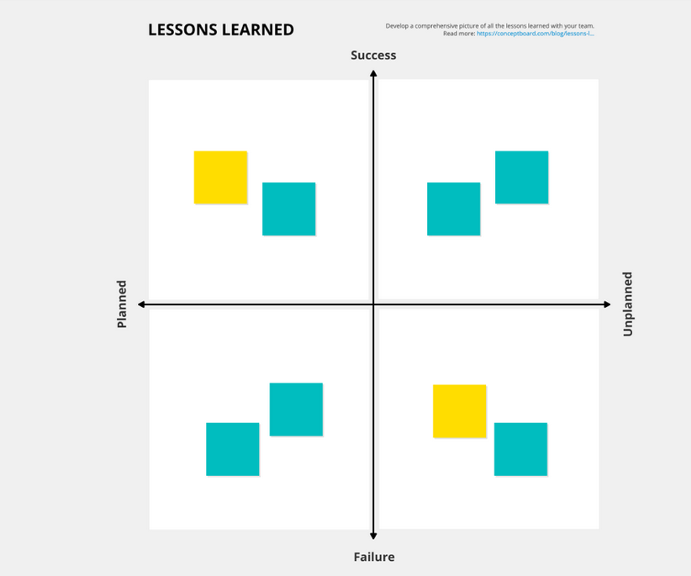
Lessons Learned
In general, our sprint planning was really poor, having problems with the building and running of the Project since very early on and having fixed it very late. We learned that a timely completion of user stories heavily relies on establishing a strong foundation during project setup and neglecting it can lead to a serious delay.
Some user stories were only able to be completed during Sprint C, which is having a better planning.
We are here

Slide 8
eCourse Progress Report – Sprint B
Pedro Mesquita – 1211171
Luís Monteiro – 1211250
Miguel Pessanha – 1201078
Tiago Afonso - 1201305

